Slide 1
Theory
CODI 2014 Lecture

Slide 2
Rules of Debate
Debate has surprisingly few rules
Time limits and speaking order
There must be a winner and loser
No outside assistance
Don’t clip cards
What you do in rounds is up to debate

Slide 3
Role of Theory in Debate
Establishes best practices for the debate round
A way for debaters to object when the other team does something sketchy
Debate theory is a normative statement of what debate should be like
All theory arguments focus on the question of what would be best for debate

Slide 4
Model for Theory Arguments
X is the correct way to understand debate
The other team deviates from X
The other team should lose because debate would be worse if everyone did what they were doing

Slide 5
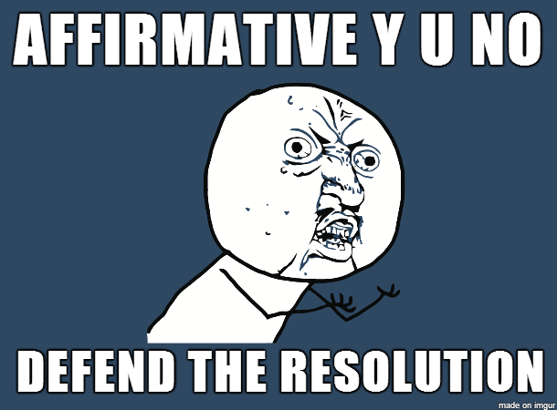
Topicality
Debate should be about the resolution
There is a preferred meaning to the resolution

Slide 6
Parts of a Topicality Argument
Interpretation
Violation
Reasons to Prefer/Voting Issue

Slide 7
Interpretation
Heart of any Topicality or other theory argument
This is the statement about what you think would be best for debate
For topicality it usually means defining a word in the resolution

Slide 8
Violation
Explanation of what the other team did wrong
How do they deviate from your interpretation

Slide 9
Interpretation
Resolved: The United States federal government should substantially increase its non-military exploration and/or development of the Earth's oceans.
The affirmative plan is: The United States federal government should increase funding for the Japanese Whaling Association’s scientific research of sustainable whale harvesting.

Slide 10
Reasons to prefer
Why is your interpretation best for debate
Usually a question of what makes the game the fairest
Examples- ground, predictability, education etc.

Slide 11
Other forms of topicality
Extra Topical- the affirmative plan does some things that are topical, but also takes nontopical action
i.e. increase funding for ocean development by cutting the B-2 bomber program
Anything that does MORE

Slide 12
Other Forms of Topicality
Effects-Topicality
The plan action itself is not topical, but eventually leads to topical actions.
i.e. increase military sonar development to make better maps of the ocean that will eventually be made public
i.e. stop a current program that is hindering development of the ocean

Slide 13
Why Run Theory?

Slide 14
Common Theory Examples
Vs. Counterplans
PICs are bad
Too many agents
Anything that steals aff ground
Conditionality is bad

Slide 15
Vs Kritiks
Alternative is cheating
The neg does not get any alternative

Slide 16
Vs permutations
Severance perms are bad
Intrinsicness perms are bad
Time Frame Perms are bad

Slide 17
Specification
Agent (can’t just say USFG)
Anything that is inherently vague about the plan

Slide 18
Some Theory Warnings
It should not be your go to
It is many teams’ go to
You will not get good speaker points going for theory
Too much is annoying

Slide 19
Answering theory
Topicality
We meet their interp
Counter-interp
We Meet the Counter-interp
Our interpretation is better
Defense against their reasons to prefer

Slide 20
Answering Theory
Why what you are doing is good for debate
Why their version of debate would be bad
Defense against their claims

