Slide 1
Debating Case and Disadvantages
CODI 2014 Lecture 1

Slide 2
Basics of a Policy Affirmative Case
Stock Issues
Significance
Harms
Inherency
Topicality
Solvency

Slide 3
Significance and Harms
How big is the problem?
How bad will things be if we don’t do anything about it?
Better understood as the affirmative advantage area

Slide 4
Significance and Harms
Overfishing Example
The Advantage is preventing ocean ecosystem collapse
From the file:
The current framework drives fish farms to other countries and guarantees a Malthusian collapse
Freeza 2012
Starvation kills billions –We have a moral obligation to act
Andre 92

Slide 5
Significance and Harms
You will also here people refer to this as the impact “What is the impact of the advantage?”
In debate, to determine if a plan is desirable we weigh the impacts of the affirmative against the impacts of the negative positions
Impacts are weighed in three dimensions: Magnitude, probability, timeframe

Slide 6
Significance and Harms
Examples from the Wind Aff
Probability: The best and most recent study has found that warming is anthropogenic with absolute certainty
Timeframe: We’re at the tipping point of runaway warming- must act now to prevent the worst impacts
Magnitude: Warming is an existential threat

Slide 7
Inherency
What is wrong with the current policies
Why the affirmative plan is not being done
Examples: Current federal policy impedes offshore aquaculture—ensures the US is dependent on unsustainable sources
Current offshore wind policy lacks stability, deterring investors

Slide 8
Topicality
Is the Plan an example of the resolution
Most affirmatives offer a concise plan of action. It is a short description of what the affirmative team advocates to fix the problems they have outlined earlier.
Plan: The United States federal government should pass the National Sustainable Offshore Aquaculture Act.
Thus the plan: The United States Federal Government should substantially increase federal tax credits and loan guarantees for offshore wind projects.

Slide 9
Solvency
How does the plan solve the problems outlined in the advantages
The plan sends a signal that increases commercialization of off-shore aquacultures, transitioning away from worst forms of fishing Cates 2010
Incentives are key to launch sustainable offshore wind- industry experts agree Environment America 2012

Slide 10
So Why do We have Stock Issues
It is what is necessary to provide a prima facie case
If one is missing the argument is incomplete- why would we pass a new aquaculture law if there is not a problem?
All types of arguments have stock issues

Slide 11
What Debates are mostly about
Do the advantages of the affirmative proposal outweigh the potential disadvantages
How big of an impact do the advantages have and how likely is it the aff will solve.

Slide 12
Offense vs. Defense
A key part of debate is understanding the difference between offensive and defensive argument
Defensive- their argument is not as true as they claim
Offensive- The opposite of what they claim is true and/or there is a better way to understand a relationship

Slide 13
Defensive Examples
Global warming is not real
Wars will not happen
Their card does not say that
Their evidence is old
Most defensive arguments by themselves amount to the claim made by the other team is not as true as they would like it to be

Slide 14
Offensive arguments
The plan makes things worse (solvency turn or disadvantage)
They said global warming is bad, it is really a good thing
They said the plan was unpopular, it is really popular
Most offensive arguments are labelled as “turns”

Slide 15
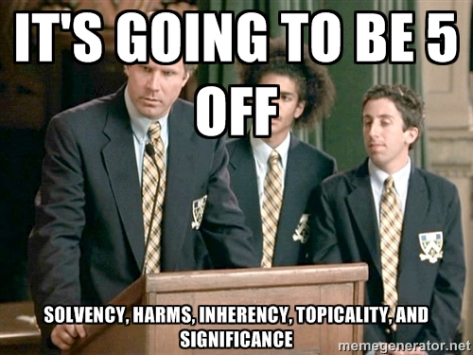
Disadvantages
The core of negative offense
They are “off case” positions

Slide 16
Disadvantages
The negative consequences of doing the plan
Are off case positions because it is likely in an area the affirmative has not brought up
For example- vs the fisheries aff we have the NOAA tradeoff DA

Slide 17
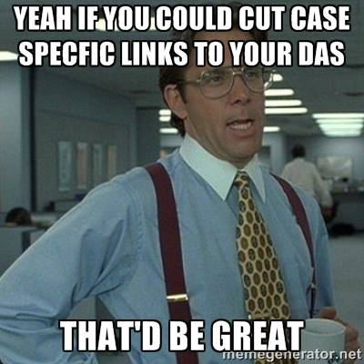
Parts of a DA
Links- the most important

Slide 18
Links
Two types- plan action and solvency action
The first step in a chain of events
i.e. it costs money to set up fisheries management
That money has to come from somewhere- oh yeah it will come from weather forecasting satellites

Slide 19
Uniqueness
Every thing is OK now
For the Aff UQ is things are getting worse
We have plenty of money for NOAA Weather Satellites Now

Slide 20
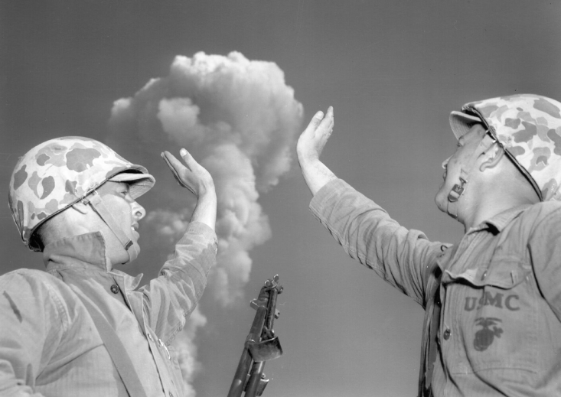
Impacts
Just like the affirmative impacts
Magnitude, probability, timeframe
Decline of readiness guarantees China, Russia, and North Korea lash out causing escalation and global war Olsen 14

Slide 21
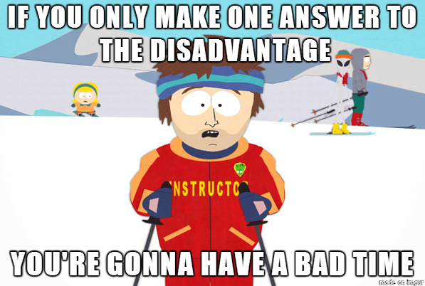
Answering Case Advantages and Disadvantages
Have a mix of offense and defense
One answer will not win you a round

Slide 22
Have diversity in your answers
Turn
Uniqueness
Link
Impact
Probability

