Slide 1
Counterplans
CODI 2014 Lecture 2

Slide 2
What is a counterplan?
A plan offered by the negative to solve some or all of the affirmative’s advantages
The negative can choose to do whatever they want, but it must be competitive with the affirmative
In order to be competitive there must be a disadvantage to doing both the affirmative and the negative together (permutation)

Slide 3
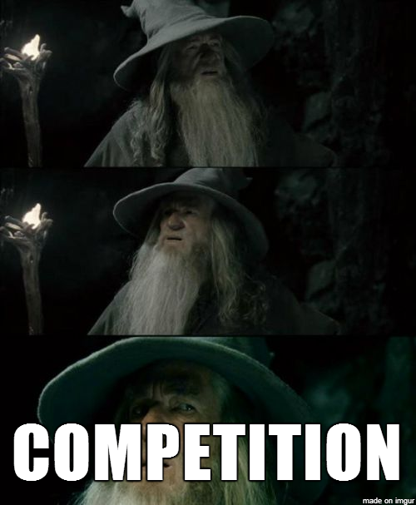
Competition
Comes from Net Benefits
Usually DA’s or case turns that link to the affirmative plan but not the counterplan
Fast Food example

Slide 4
Why Counterplan?
To eliminate consideration of the aff advantages
More realistic to offer a better way of doing things
Time

Slide 5
Types of Counterplans
Agent Counterplans
Have a different actor do the same thing as the aff
Sometimes difficult because a good aff will find something only the resolutional agent can do
Need to always have a warrant why your actor is best in the 1AC
NOAA regulations key/off shore wind done in federal waters

Slide 6
Types of Counterplans
Advantage Counterplans
Do something else to solve some or all of the aff harms
Vs wind- a different energy source
Vs fisheries- only allow fisheries on land
Solve just one advantage- i.e. do something to solve for global warming

Slide 7
PIC Out of
PIC= Plan Inclusive Counterplan
Do all of the plan except…
Change the wording of the plan
Exclude some state or area from the plan effects
Implement the wind plan except in waters off of x state
The goals is to do as much as the aff as possible with a DA to the one thing you change

Slide 8
Conditions CP
Only do the plan if x happens
Consult NATO or a country
Spending conditions

Slide 9
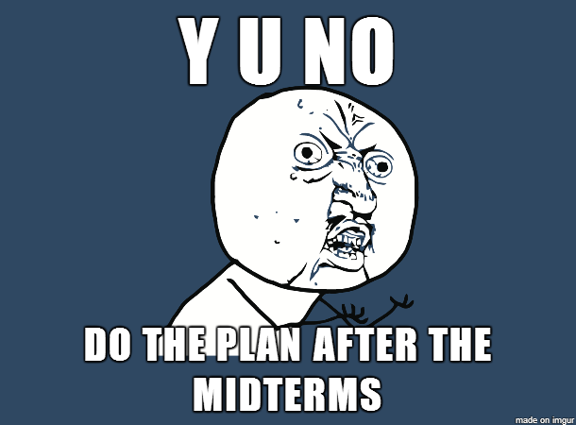
Delay Counterplans
Do the plan at some later date
Usually after the Disad- i.e. after the midterms

Slide 10
What is wrong with some of these counterplans
They are probably cheating
The closer to the affirmative the CP is (i.e. the more the plan it does) the harder it is for the affirmative to answer it
Good for the negative, bad for the affirmative

Slide 11
Answering Counterplans
Permutations
Offense
Solvency Deficits
Theory

Slide 12
Permutations

Slide 13
Permutations
Combination of the plan and the counterplan
Should include all of the plan and parts of the counterplan
Perm do both- all of the plan and all of the counterplan is the most common form
Should be your first answer to most CPs

Slide 14
Permutations
Instrinsicness Permutations
Adds something to the plan and counterplan that is not in either
Timeframe Permutations
Do the plan and then the counterplan or do the counterplan and then the plan
Severance Permutations
Eliminates part of the plan

Slide 15
Point of the Permutation
To show the counterplan is not competitive
It should solve all of the affirmative advantages and the negative disadvantages associated with the plan
This will also be true for permutations of kritiks

Slide 16
Offense
A turn or disadvantage to the CP
VS states cp- state spending DA
Reason why the counterplan action would make things worse

Slide 17
Solvency
You must make an argument why the CP does not solve all or some of the aff
If you do not then any risk of the negative disadvantage means you lose
Most solvency deficits are built into the 1ac- a good 2ac will make several solvency deficit arguments relying on 1AC evidence alone

Slide 18
Theory
The negative’s counterplan is cheating
Status of the counterplan
What the Counterplan Does

Slide 19
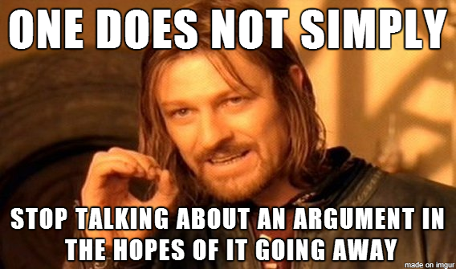
Status of the Counterplan
Conditional
The negative can kick it at any time/the status quo is always an option
Kick it? WTH does that mean?

Slide 20
Status of the Counterplan
Dispositional
The negative can only kick the counterplan if there is a permutation or other relevant theoretical objection.
Unconditional
The negative cannot kick the counterplan

Slide 21
What the Counterplan Does
Fiat Abuse
Multiple Actors

Slide 22
Fiat Abuse
Does something nobody writes about
Uses an international agent

Slide 23
PICS
Steal Aff ground
Artificially competitive
Impossible to debate fairly

